Slide 1
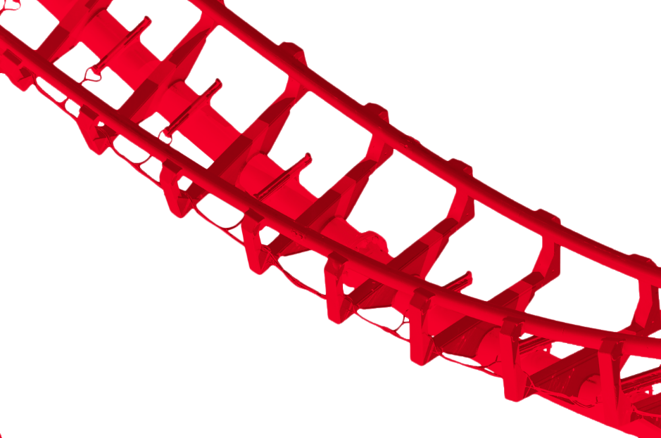
Coaster Crunch
A project by Team Blue

Slide 2
What is Coaster Crunch?
Coaster Crunch is a single page web application that aims to inform readers about the different types of roller coasters that can be found throughout the world.
Team Blue built a database from scratch, utilizing resources around the web.

Slide 3
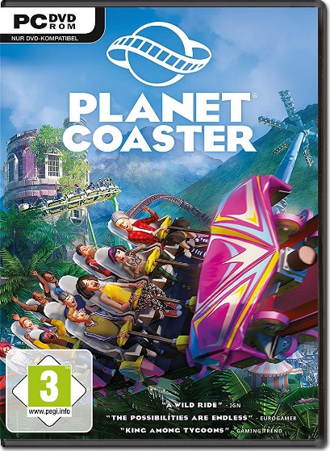
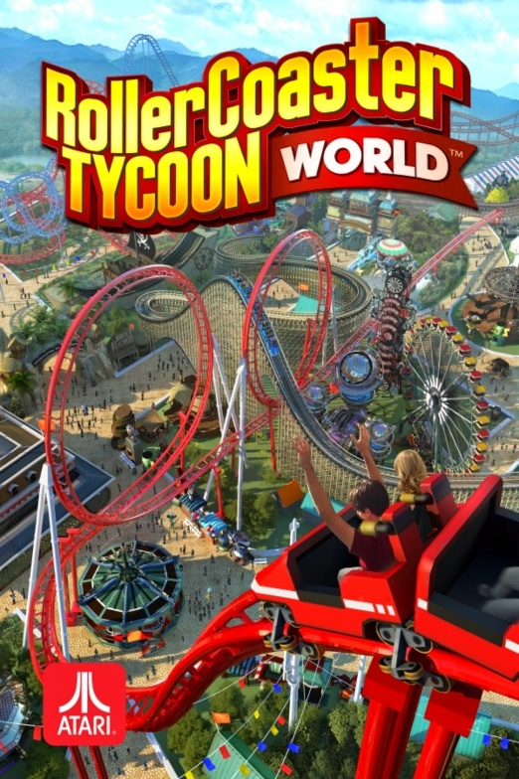
Who is it for?
The objective of Coaster Crunch is to provide coaster
enthusiasts with a simple set of data that provides more
information about their favorite thrill rides.
Readers might use this as an inspiration to place new
coasters on their "must-ride" list, or build them in
coaster emulation games such as
Planet Coaster and Rollercoaster Tycoon.

Slide 4
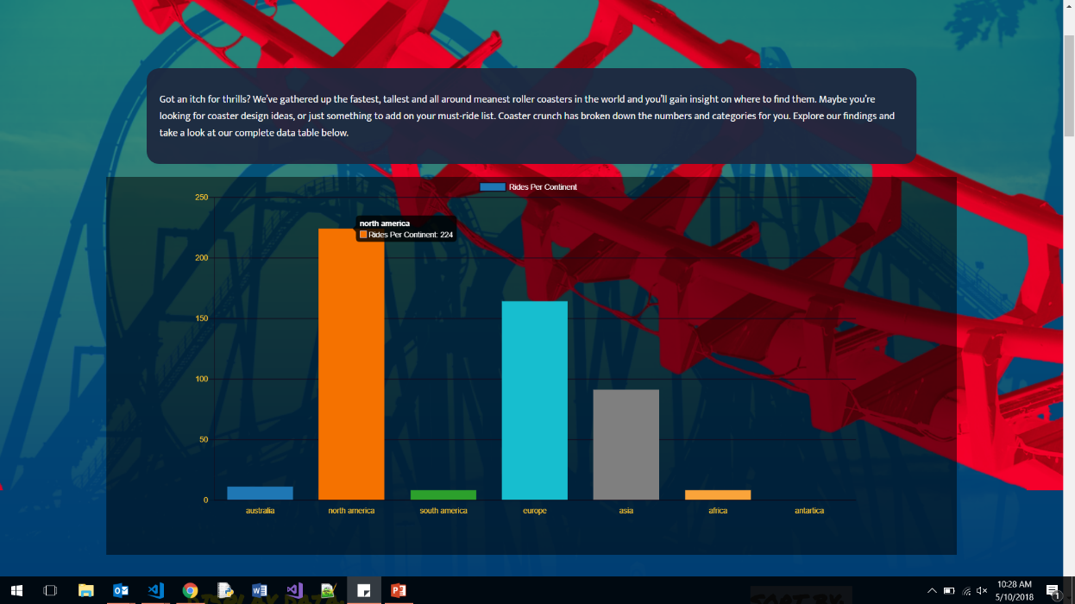
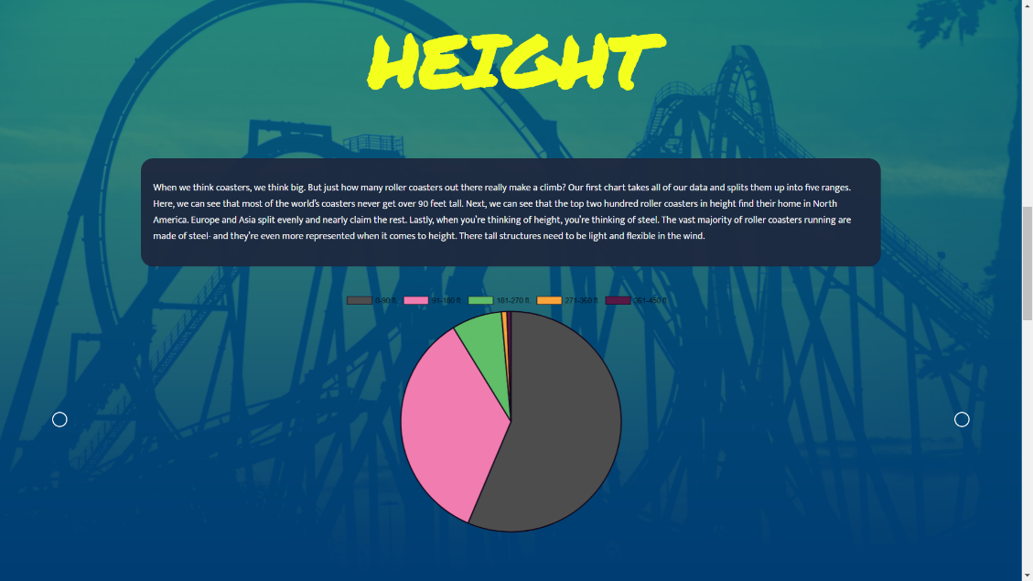
DESIGN
The Page is broken into 3 major components: The main bar graph, a collapsible data table and three pie charts.
Here we have a sample of the main bar graph and one of the pie charts. We will go into greater detail on their inner workings soon.

Slide 5
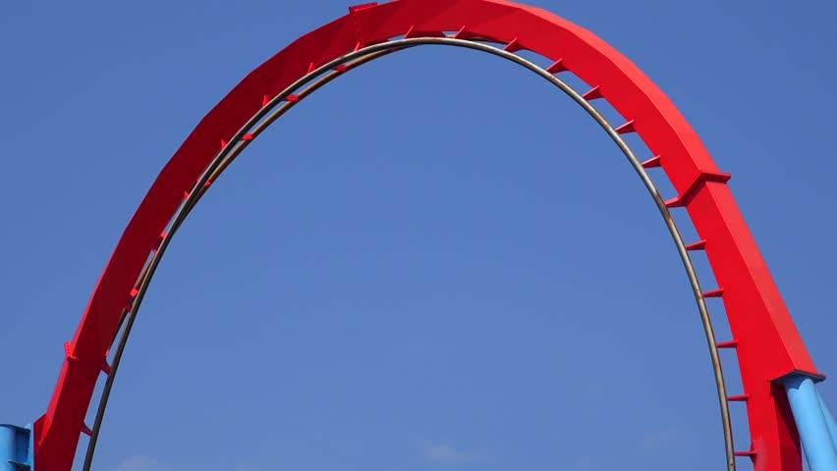
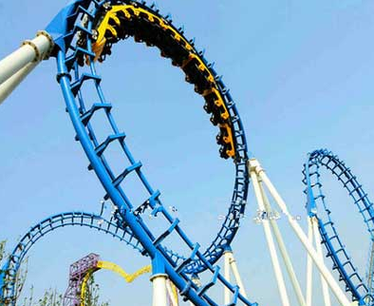
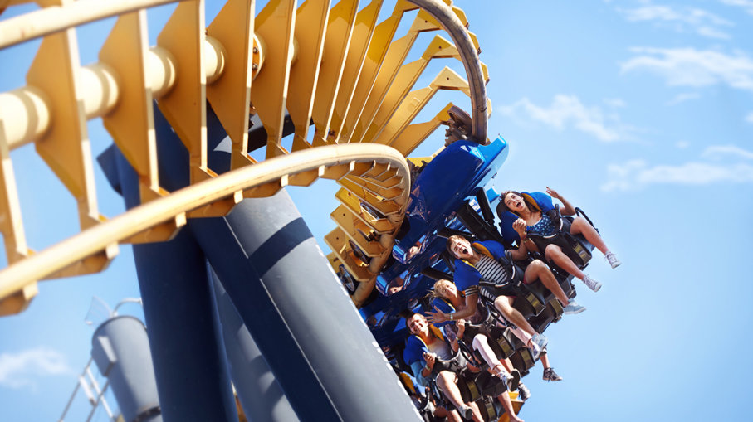
DESIGN
For color design, we wanted the page to be bright and even a little loud. We drew inspiration from the basic color combination associated with carnivals and circuses; red and yellow. Blue is a complementary color in this design scheme. Each color can commonly be found on roller coasters as well.

Slide 6
The Database
The database that we used consists of 508 JSON objects. These objects have 7 key value pairs that we used to generate the results that you see on this project.
These value pairs are name, length, height, speed, type, park, and continent. With this database, users are visually presented multiple charts that break down different statistics, from coasters per continent, to average speed and more.

Slide 7
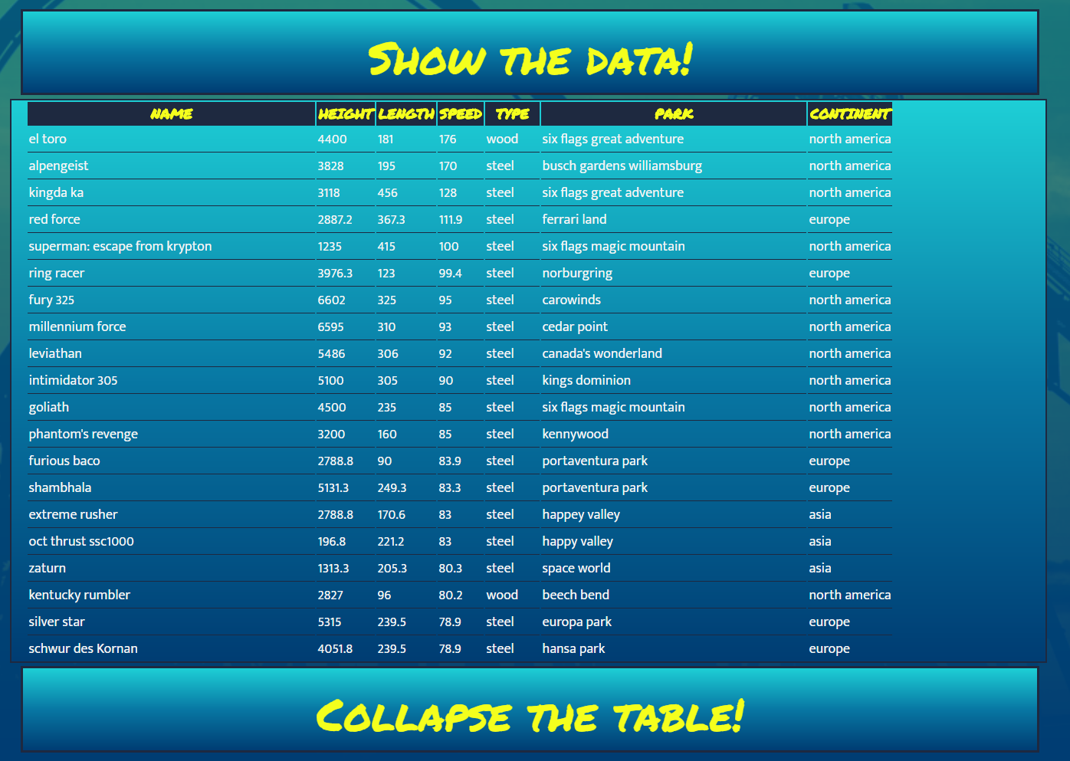
The Database
The data can be accessed by the user with a table on the page. This table can be instantly sorted in ascending or descending order based on height, speed or length.
The table is contained and scrollable, and the user my collapse that table at any time. The table will also show the user what type of material the coaster is built from, as well as the park it operates in and on what continent.

Slide 8

How is it all done?

Slide 9
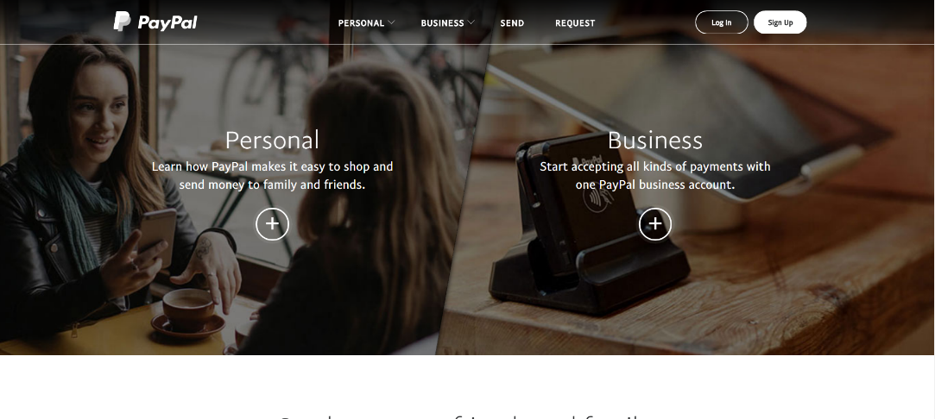
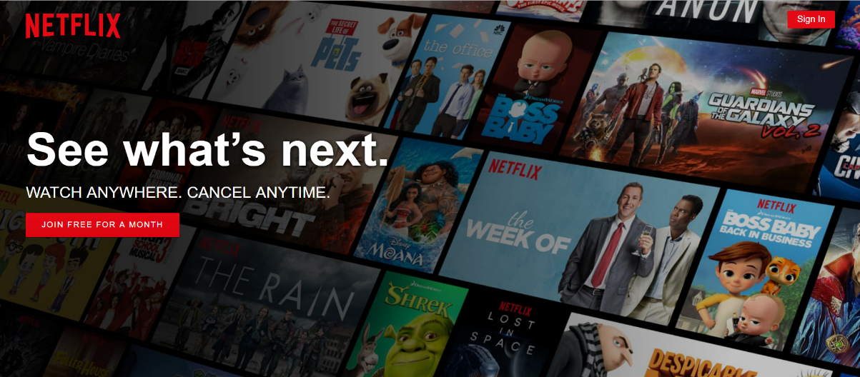
What is Angular?
Angular is a platform and framework for building client applications in html and typescript. Angular applications are written using typescript (similar to javascript) and is developed by google.
Angular has 3 versions (Angular js, Angular 2, Angular 4, Angular 5 on the way?)
Websites built with Angular include Paypal and Netflix

Slide 10
Angular Overview
An application is a collection of components.
The top level component is the application itself. This sits in the “app” folder. This means the application is a component calling in all other components.
The application component is not the only component that may call another, however. When a component is called and rendered, it will call any of its child components along for the ride.
The basic building blocks of angular are ngModules which provide a compilation context for your components.

Slide 11
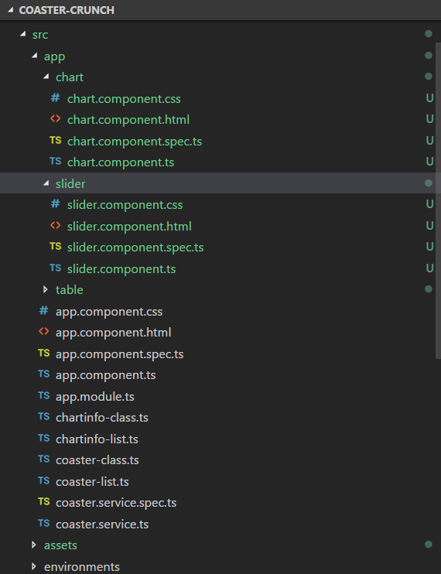
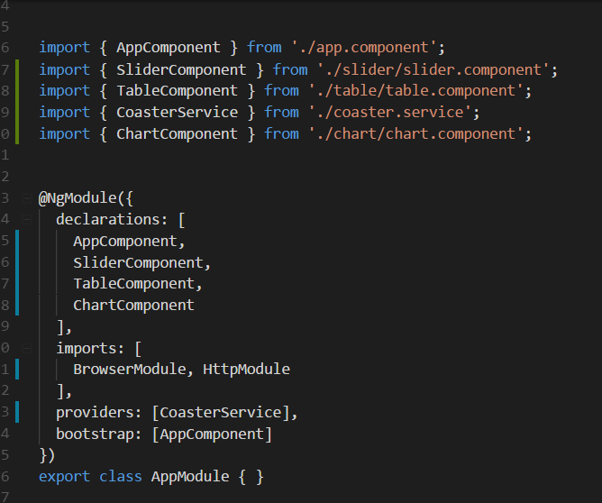
Angular OVERVIEW
An overview of the components layout and the @NgModule

Slide 12
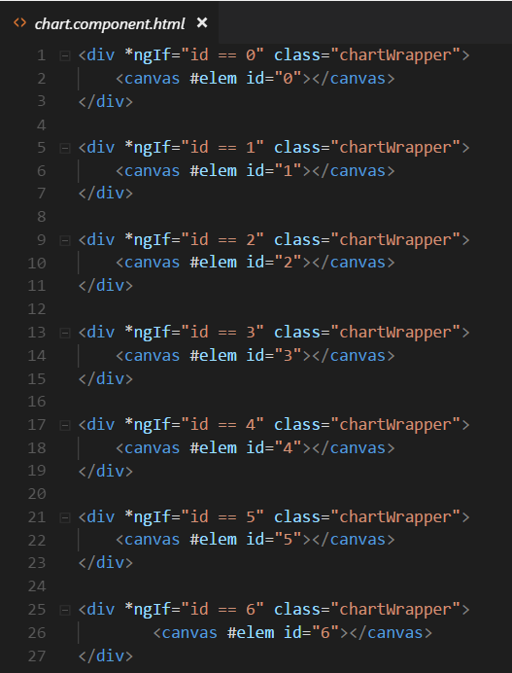
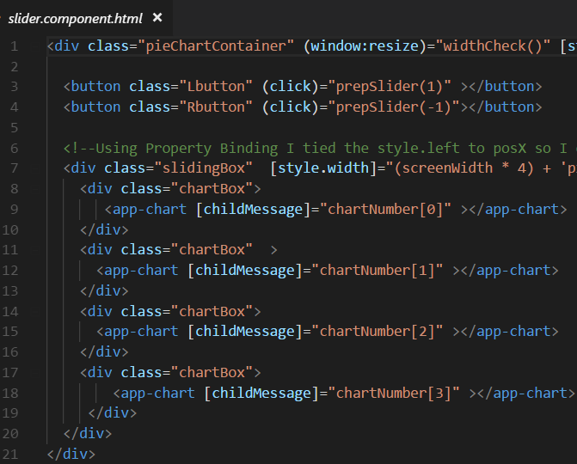
Angular OVERVIEW
A sample of the chart component template, and how that is inserted into the slider component.

Slide 13
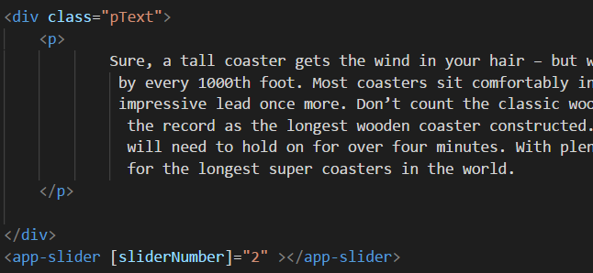
ANgularOverview
Templates are a combination of HTML and Angular markup that modify the HTML displayed in the view.
Angular directives are programing logic that can be put into the HTML markup.
Here is a small example of the insertion of a slider template, which as we have seen on the previous presentation slide, has a chart component template nested within.

Slide 14
Angular Overview
This comes together with property binding. Property binding is a feature that allows you to pass data from the component class to an element in the component’s template.
Event Binding is making your app listen for certain user actions and then updating the app accordingly.
Binding uses {{curly_backets}} to indicate where the data is being passed in.
Information is supplied to the components via services. Services perform operations that are not related to the view.

